Slide 1
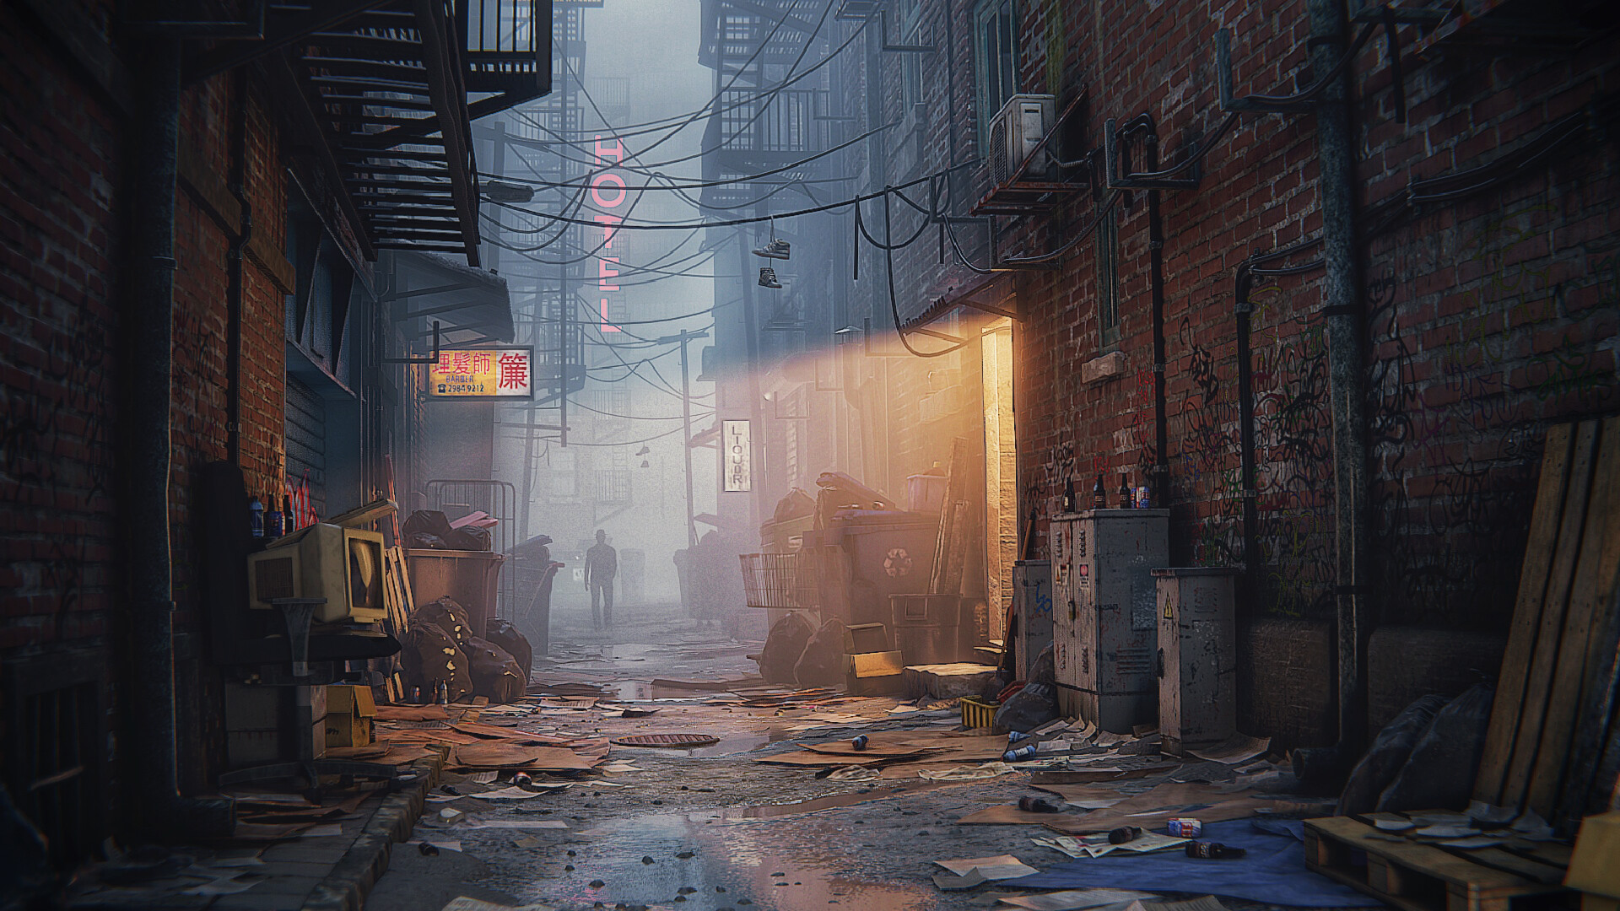
Workshop 3 CHALLENGE

Slide 2
Bonus Task
If you’ve completed your playground you can try doing one of the following extra tasks.

Slide 3
Bonus Task
Pick one of the following if you haven’t completed any of the previous challenges.
Change the lights in your scene to the opposite time of day. If its night time, quickly model some street lights. If its day time, reposition your global light and change its colour.
Change the lights to create a different mood/ theme in your scene. For example, using red/black lighting can make your scene look ominous and scary.

Slide 4
Bonus Task – Previous Challenges
Pick one of the following if you have completed one of the previous challenges
Light your boat in a scene. This can be the boat by itself or with the character fishing off of it.
Light you characters playing rock paper scissors. The lighting may change based on the location. Are the characters playing on a stage? Be creative!
Light your character dancing. Have a spot light follow them around or create some soft ambient lighting to set a mood.

Slide 5

Rendering
If you have time, try rendering out one of the challenges.
If you need a reminder on the settings needed to render out your scene look at the animation and lighting powerpoint.

